Slide 1
Operating Systems (Process Management)
Presented By Sudeshna Kundu (Mondal)

Slide 2
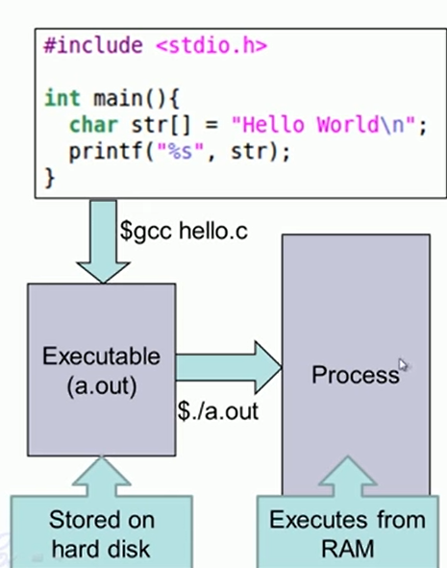
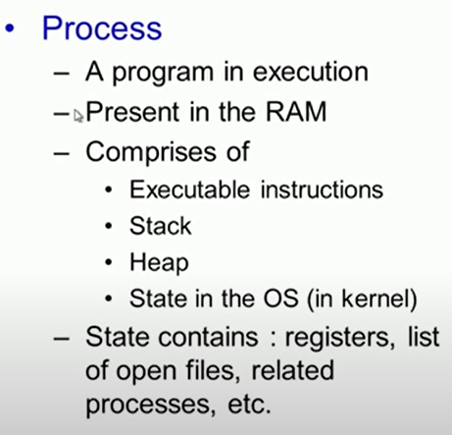
Executing Apps (Process)

Slide 3
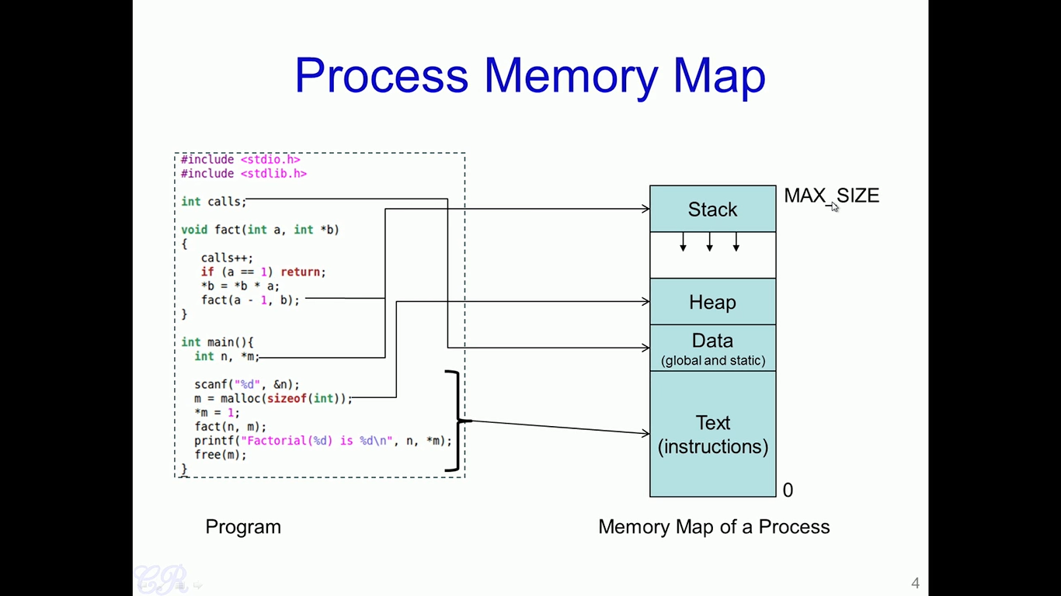
Process Memory Map
S.N. | Component & Description
1 | Stack The process Stack contains the temporary data such as method/function parameters, return address and local variables.
2 | Heap This is dynamically allocated memory to a process during its run time.
3 | Text This includes the current activity represented by the value of Program Counter and the contents of the processor's registers.
4 | Data This section contains the global and static variables

Slide 4
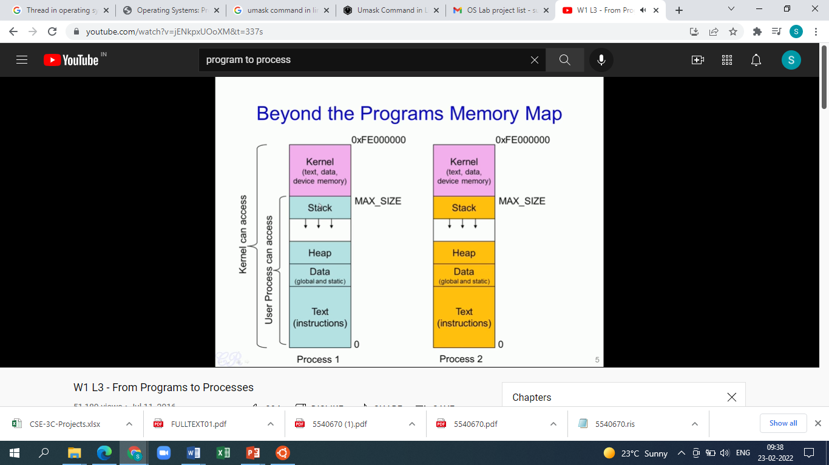

Slide 5
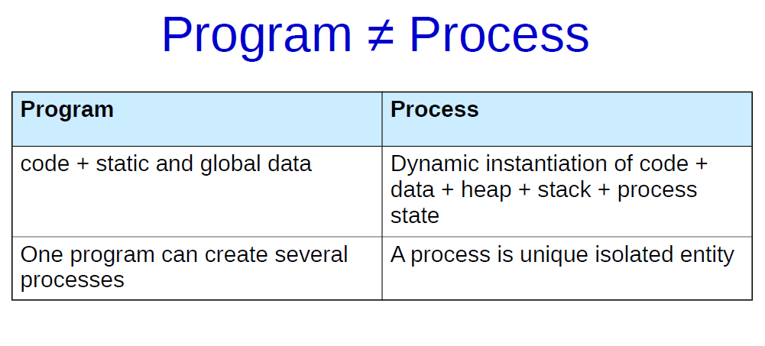

Slide 6
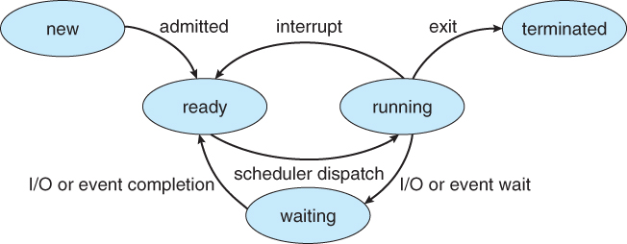
Process State
Processes may be in one of 5 states,
New - The process is in the stage of being created.
Ready - The process has all the resources available that it needs to run, but the CPU is not currently working on this process's instructions.
Running - The CPU is working on this process's instructions.
Waiting - The process cannot run at the moment, because it is waiting for some resource to become available or for some event to occur. For example the process may be waiting for keyboard input, disk access request, inter-process messages, or a child process to finish.
Terminated - The process has completed.

Slide 7
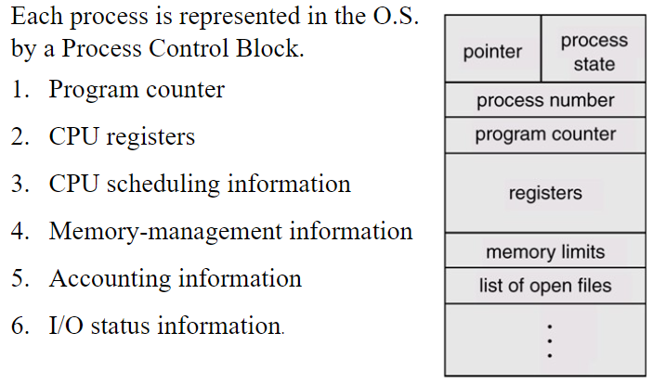
Process Control Block

Slide 8
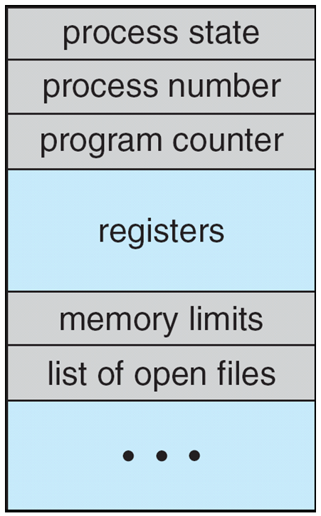
Process Control Block (PCB)
Information associated with each process
(also called task control block)
Process state – running, waiting, etc
Program counter – location of instruction to next execute
CPU registers – contents of all process-centric registers
CPU scheduling information- priorities, scheduling queue pointers
Memory-management information – memory allocated to the process
Accounting information – CPU used, clock time elapsed since start, time limits
I/O status information – I/O devices allocated to process, list of open files

Slide 9
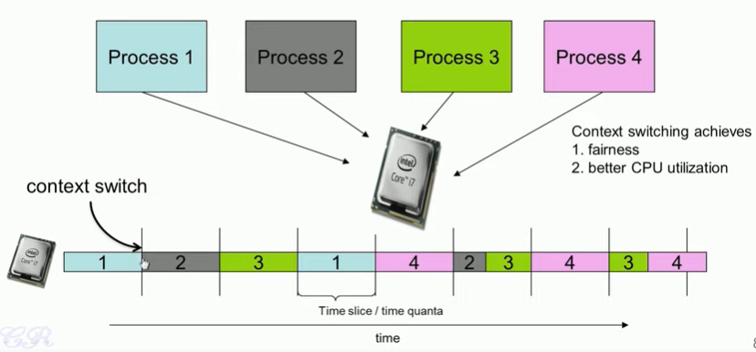
CPU Context Switching

Slide 10
CPU Context Switching
Multitasking enables that this CPU is fairly shared among the various processes
In a multitasking enabled operating system, the OS would allow one process to execute for some time, and then there is a context switch.
When CPU switches to another process, the system must save the state of the old process and load the saved state for the new process
Context-switch time is overhead; the system does no useful work while switching
Processes execute for brief intervals of time known as time slices
What triggers a context switch in an operating system?
Blocked for IO
Zombie state
Timer interrupt

Slide 11
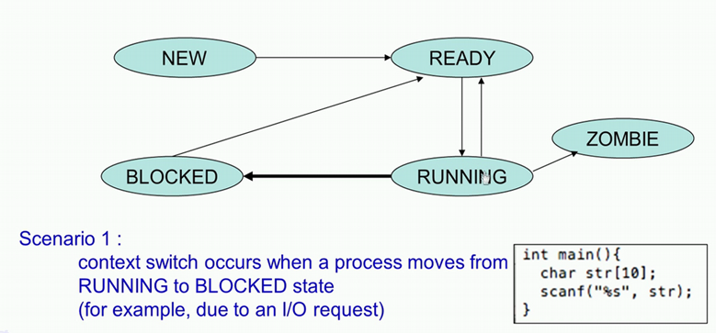
CPU Context Switching (IO Request)
When the scanf() function gets invoked process is blocked until a user inputs data through the keyboard.
State of the process changes from the running state into the blocked state.
Therefore, a new process will come from the ready state into the running state.

Slide 12
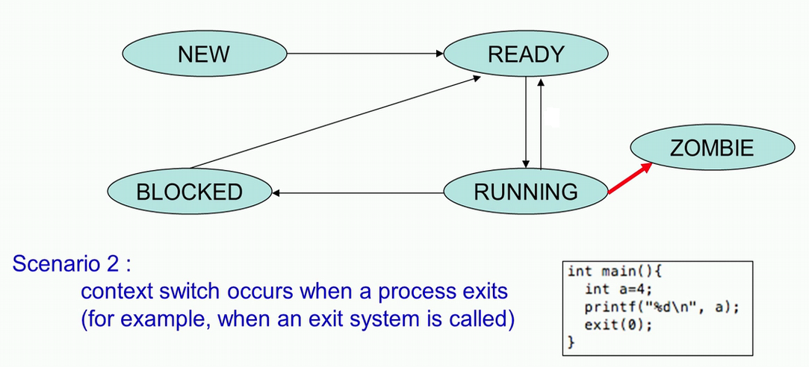
CPU Context Switching (Zombie)
At the end of the exit system call, the operating system will trigger a context switch.
Process in a exiting mode will not have the CPU resources anymore, new process will be assigned the CPU
Therefore, a new process will come from the ready state into the running state.

Slide 13
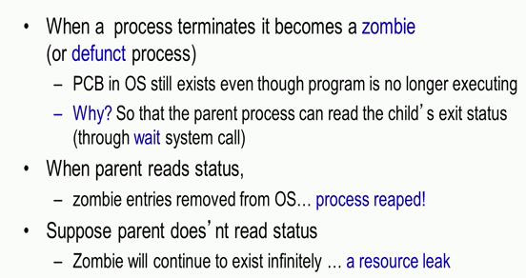
Zombie

Slide 14
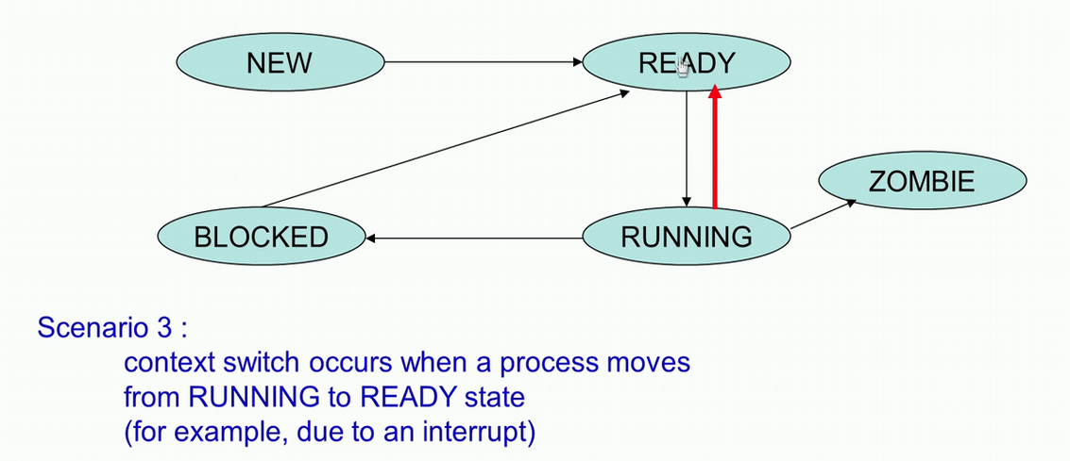
CPU Context Switching (Timer Interrupt)
Process is in a running state, events like hardware interrupt occurs, lead to a context switch.
Process is currently executing or currently holding the CPU, interrupt occurs it moves from the running state into the ready state.
Interrupt would cause an interrupt handler to execute
New process will move from the ready state into the running state.

Slide 15
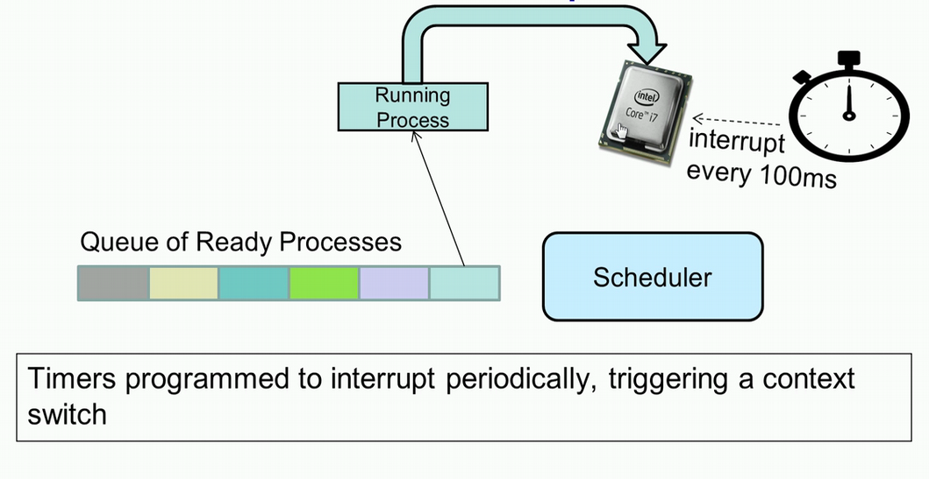
Context Switching for multitasking

Slide 16
Context Switching for multitasking
A very popular interrupt in this context is the Timer interrupt. Now all systems have a timer within them. So, this is configured to send interrupts periodically to the CPU. The period could be anything from 10 milliseconds to 100 milliseconds, and may vary from system to system or when the timer interrupt occurs, the OS gets triggered and it causes a CPU scheduler to execute.
CPU scheduler looks at the queue of processes which are in the ready state, and then based on some algorithm will choose a particular process. So, this process would then be moved from the ready state into the running state, and it would be this process that would execute in the CPU until the next interrupt occurs.
In every 100 milliseconds, the scheduler would pick a new process to execute and that process would then hold the CPU for the time slice of 100 milliseconds.

Slide 17
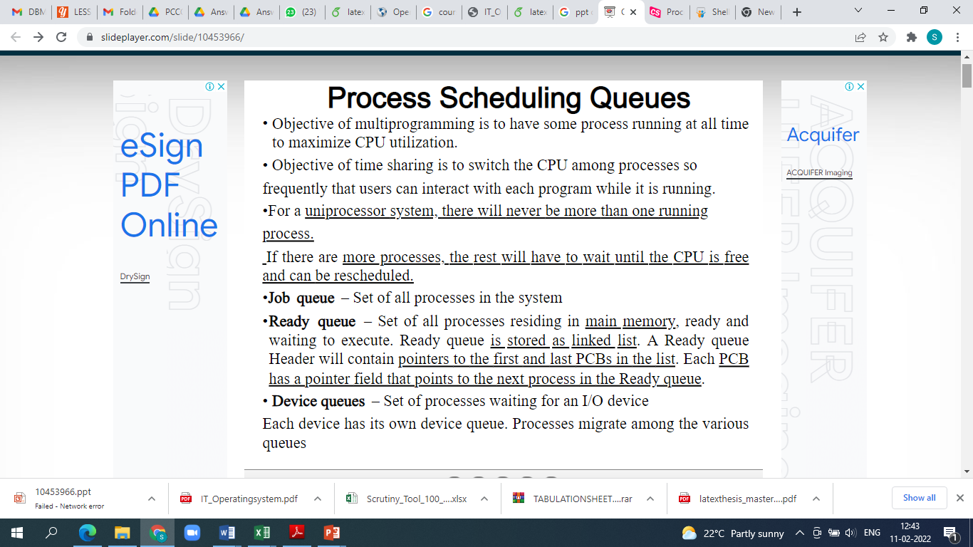
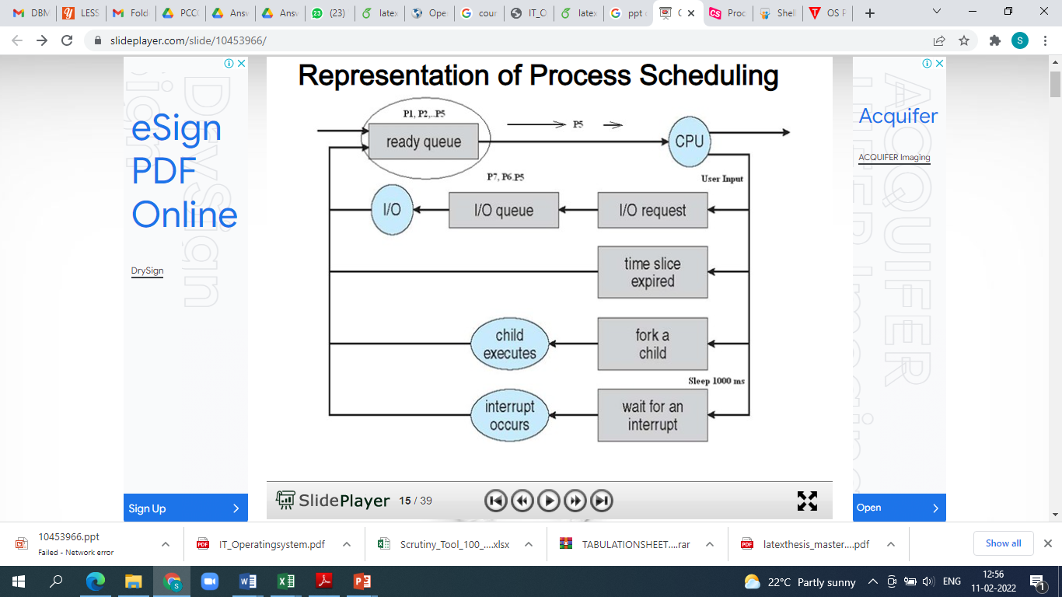
Process Scheduling Queues

Slide 18
Process Scheduling Queues

Slide 19
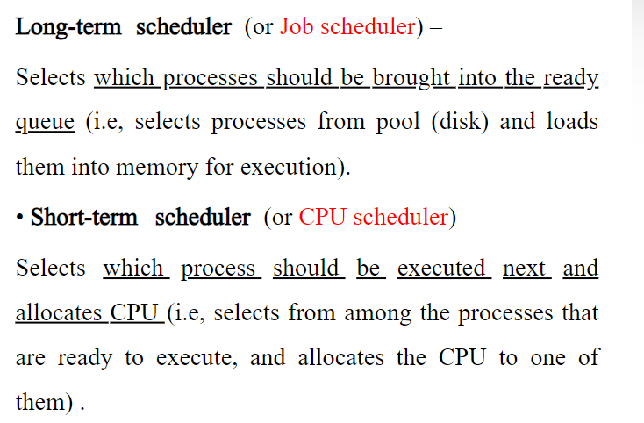
Schedulers

Slide 20
Type of Schedulers
Long-term scheduler (or job scheduler) – It chooses the processes from the pool (secondary memory) and keeps them in the ready queue maintained in the primary memory. It bring the new process to the ‘Ready State’. It controls Degree of Multi-programming. Long-term scheduler is invoked very infrequently (seconds, minutes) ⇒ (may be slow)
Short-term scheduler (or CPU scheduler) – selects which process should be executed next and allocates CPU. Sometimes the only scheduler in a system. Short-term scheduler is invoked very frequently (milliseconds) ⇒ (must be fast)
Medium-term scheduler: It mainly does swapping (moving processes from main memory to disk and vice versa). To add to the number of processes that are in the main memory. Decides which process to swap in or out It is invoked when there is a need to swap out blocked processes.
It can happen in case when all processes are blocked for I/0 and there is no ready process to execute. Moreover, there is no space for any other processes in main memory.
It removes the processes from the memory and reduces the degree of multi-programming.
The medium-term scheduler is in-charge of handling the swapped out-processes

Slide 21
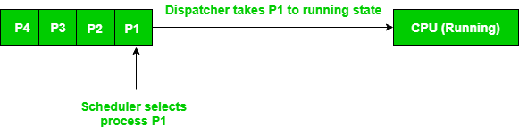
Dispatcher
A dispatcher is a special program which comes into play after the scheduler. When the scheduler completes its job of selecting a process, it is the dispatcher which takes that process to the desired state/queue. The dispatcher is the module that gives a process control over the CPU after it has been selected by the short-term scheduler. This function involves the following:
Switching context
Switching to user mode
Jumping to the proper location in the user program to restart that program
Dispatch latency – time it takes for the dispatcher to stop one process and start another running.
Example – There are 4 processes in the ready queue, P1, P2, P3, P4; Their arrival times are t0, t1, t2, t3 respectively. A First in First out (FIFO) scheduling algorithm is used. Because P1 arrived first, the scheduler will decide it is the first process that should be executed, and the dispatcher will remove P1 from the ready queue and give it to the CPU. The scheduler will then determine P2 to be the next process that should be executed, so when the dispatcher returns to the queue for a new process, it will take P2 and give it to the CPU. This continues in the same way for P3, and then P4.

Slide 22
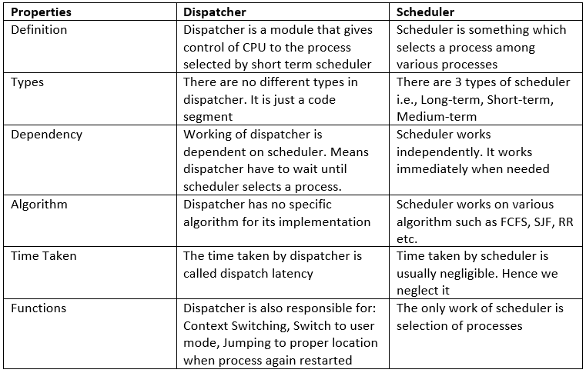
Difference between Dispatcher and Scheduler

Slide 23
THANK YOU

